Slide 1
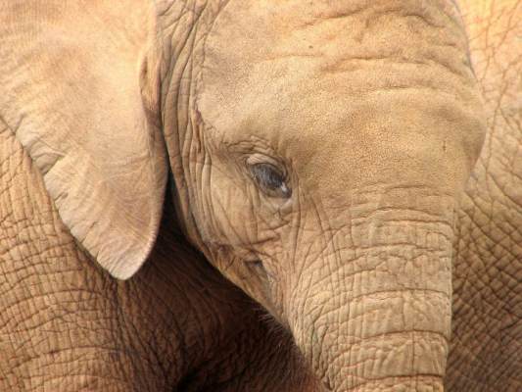
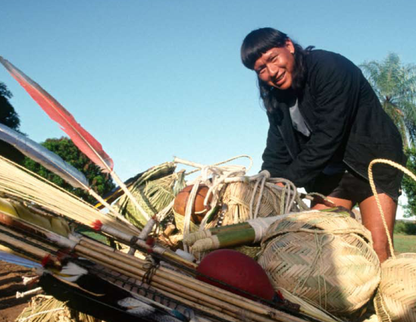
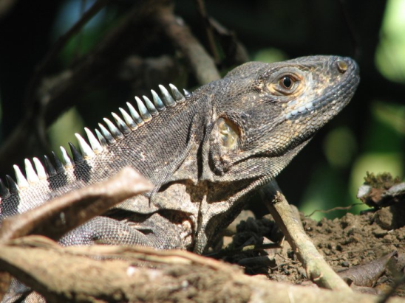
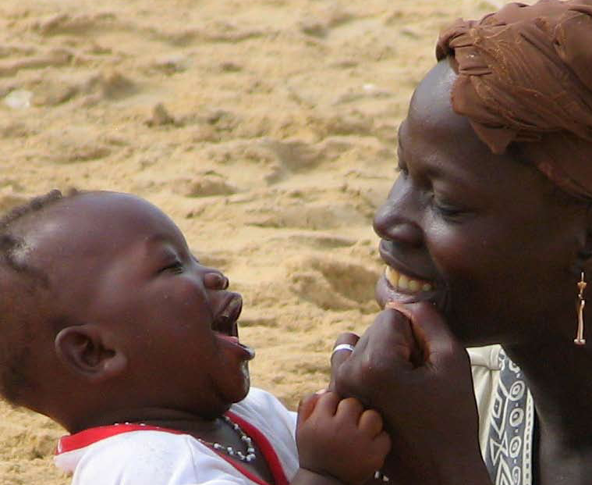
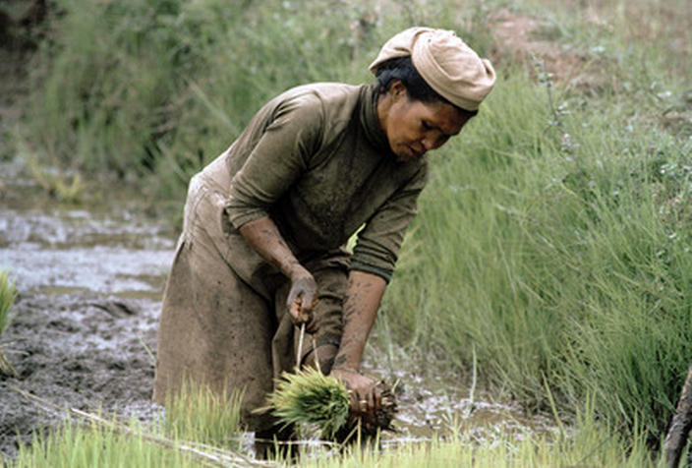
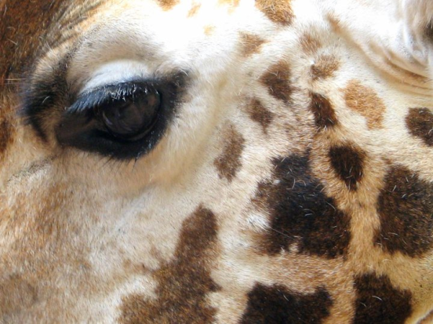
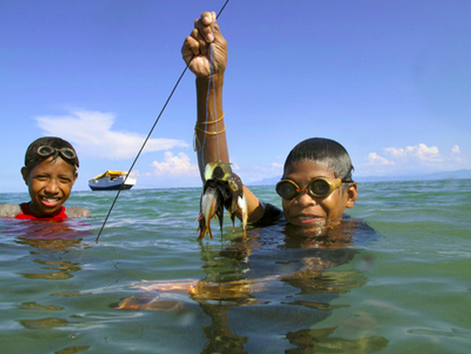
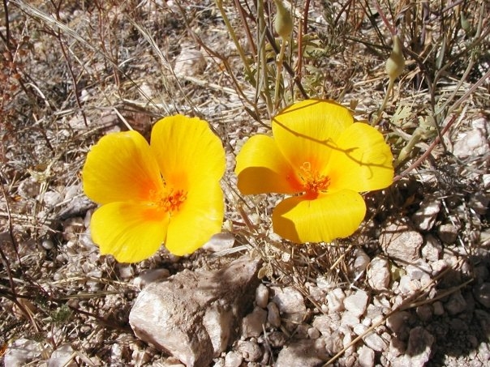
LOCAL ACTION TO STRENGTHEN RESILIENCE

Slide 2
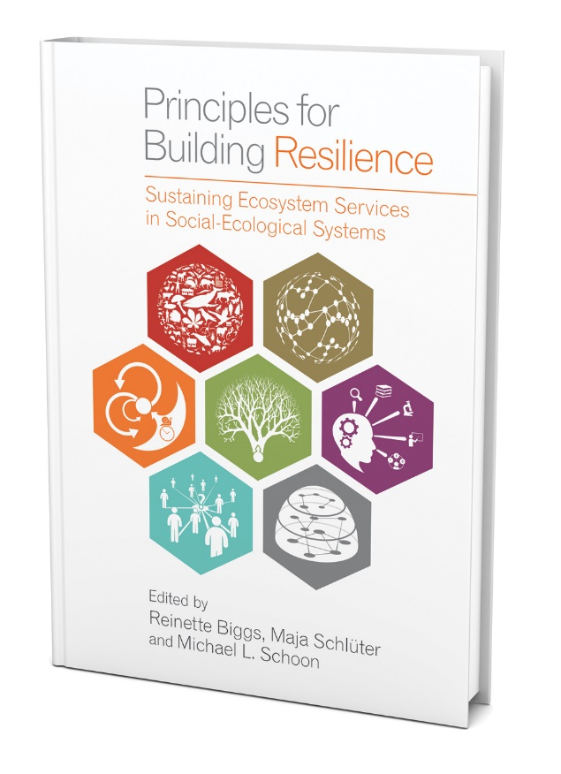
PRINCIPLES OF RESILIENCE
Biggs et al., 2015. Principles For Building Resilience

Slide 3
1. MAINTAIN DIVERSITY
Maintain a diversity of species, landscapes, institutions, crops, genes, responses, governance types
Question: How have you promoted diversity in your community, including biodiversity, agricultural diversity, and cultural diversity?

Slide 4
2. MANAGE CONNECTIVITY
Maintain connectivity between habitats, flyways, protected areas, rivers, markets, communities.
Question: What kind of connectivity as your community promoted? How has this connectivity strengthened your community?

Slide 5
3. MANAGE FEEDBACK LOOPS
Feedback loops, both negative and positive, reinforce and accelerate ecological and social processes.
Question: What are some of the feedback loops in your community? How do you manage these feedback loops?

Slide 6
4. FOSTER COMPLEX THINKING
Social-ecological systems are complex – involving many dynamic parts, processes and interrelations.
Question: How has your community promoted complex systems thinking? What are some of the systems dynamics within your community?

Slide 7
5. ENCOURAGE LEARNING
Encourage learning, experimentation, and adaptation, and mitigate against risk and failure.
Question: How have you encouraged learning and adaptation within your communities? How have you promoted risk and experimentation?

Slide 8
6. BROADEN PARTICIPATION
Broadening participation among all segments of society to ensure that results are just and socially inclusive.
Question: How have you broadened participation? What are the participatory mechanisms you’ve used in your community?

Slide 9
7. PROMOTE NESTED GOVERNANCE
Making decisions locally but within a broader political landscape, within national, regional and global frameworks.
Question: What kinds of decisions do you make locally that have broader implications? How do you ensure effective governance?

Slide 10
PRINCIPLES OF RESILIENCE
Biggs et al., 2015. Principles For Building Resilience

Slide 11
PRINCIPLES OF RESILIENCE
SUDAN: Fatima Ahmed
IRAN: Sirous Entekhabihassaniouei; Manizheh Hajighasemi
MADAGASCAR: Rakotondramanga Rafanomezantsoa; Voahanginanahary Rakotondrasoa
HONDURAS: Leana Corea Flores; Modesto Ochoa Rueda

Slide 12
ICCAS AS NATURAL CLIMATE SOLUTIONS

Slide 13
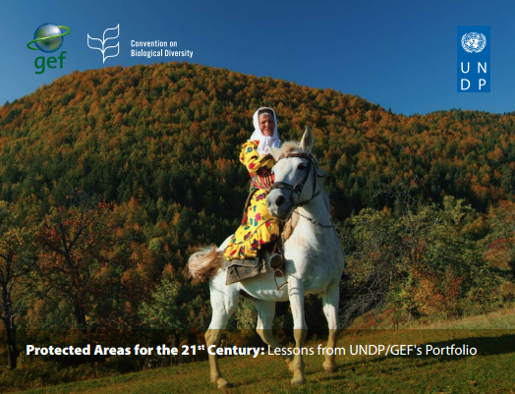
ICCAS AS NATURAL CLIMATE SOLUTIONS

Slide 14
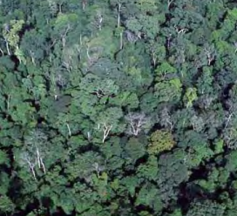
1. AVOID GHG/DEFORESTATION
ICCAs help to protect forests and other carbon-rich ecosystems, and therefore help to avoid the emissions of greenhouse gases.
Question: How has your community/ICCA helped to avoid greenhouse gas emissions?

Slide 15
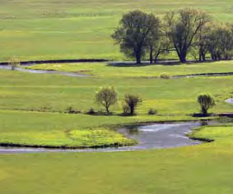
2. ENHANCE CARBON SEQUESTRATION
ICCAs help protect and manage ecosystems that can capture and store carbon, such as forests, mangroves and seagrass beds.
Question: How has your community/ICCA managed and protected ecosystems that capture carbon?

Slide 16
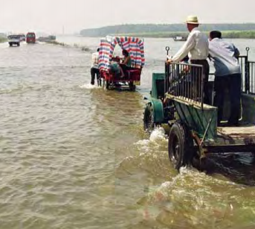
3. MITIGATE STORM IMPACTS
ICCAs protect ecosystems that can buffer the impacts of severe and more frequent catastrophic storms, such as hurricanes.
Question: How have ICCAs in your community helped to mitigate the impacts of natural disasters, such as hurricanes and floods?

Slide 17
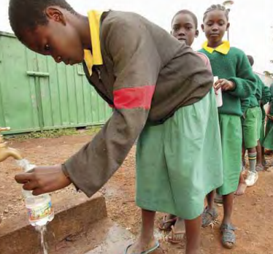
4. MAINTAIN WATER SECURITY
ICCAs protected ecosystems that maintain the quality and quantity of water necessary for sustainable development.
Question: How have ICCAs in your community helped to manage and protect ecosystems that maintain water security?

Slide 18
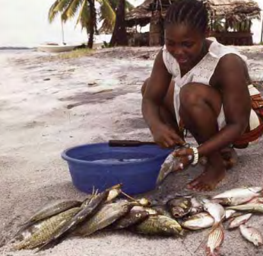
5. MAINTAIN FOOD SECURITY
ICCAs protected ecosystems that maintain the ecosystems necessary for food production.
Question: How have ICCAs in your community helped to manage and protect ecosystems that maintain food security?

Slide 19
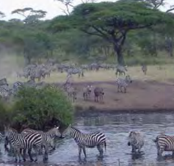
6. MAINTAIN HABITAT CONNECTIVITY
ICCAs protected ecosystems that connect to other protected areas, allowing species to shift their habitats.
Question: How have ICCAs in your community helped to promote connectivity between key habitats?

Slide 20
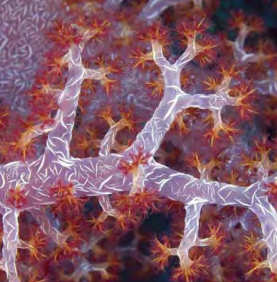
7. PROTECT VULNERABLE SPECIES
ICCAs protected ecosystems that protect species that are vulnerable to climate impacts.
Question: How have ICCAs in your community helped to protect habitats of species that are vulnerable to climate change impacts?

Slide 21
ICCAS AS NATURAL CLIMATE SOLUTIONS
PAPUA NEW GUINEA: Pagi Toko; Philiop Damen
BELIZE: Alfonso Esteban Caal; Cristina Coc; Pablo Miss
GUYANA: Tom Griffiths; Nicholas Fredericks
INDONESIA: Budi Setiawan

